Slide 1
Summoner’s Chamber
By:
Frank Boshoff
Jorrit Kornelis
Daniël Stremmelaar

Slide 2
Inhoud
Rolverdeling
Game concept
Mechanics
Art direction
User experience
Planning
Vragen

Slide 3
Rolverdeling
Frank Boshoff - Producer (Art)
Jorrit Kornelis- User Experience
Daniël Stremmelaar - Scrummaster

Slide 4

Game Concept
Tower defense
Medieval fantasy
Wizard’s Library
Story

Slide 5
Mechanics
Our ideas for towers and enemies
Towers
Magic Missile
Poison Dart
Frost Field
Fireball
Shockwave
Enemies
Gnome
Mouseman
Mushroom People

Slide 6


Art Direction
Cartoony
Fantasy
Medieval
Magic
Chaotic

Slide 7
User Experience
Light based feedback
Sound on event
Clear, readable user interface

Slide 8
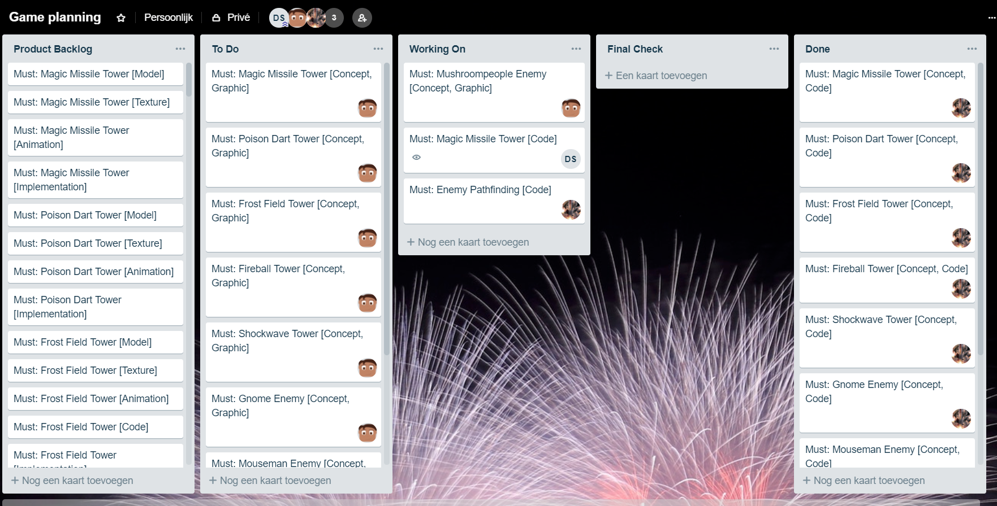
Planning
Trello
Scrum

Slide 9

Vragen?

